Slide 2
Operating SYSTEMS aND Systems Programming (CT30A3370) 6 credits
January 17, 2023
Venkata Marella

Slide 3
Chapter 12: Mass-Storage Systems
Overview of Mass Storage Structure
Disk Structure
Disk Attachment
Disk Scheduling
Disk Management
Swap-Space Management
RAID Structure
Disk Attachment
Stable-Storage Implementation
Tertiary Storage Devices
Operating System Issues
Performance Issues
Silberschatz, Galvin Operating System Concepts – 7th Edition and Gagne ©2005

Slide 4
Objectives
Describe the physical structure of secondary and tertiary storage devices and the resulting effects on the uses of the devices
Explain the performance characteristics of mass-storage devices
Discuss operating-system services provided for mass storage, including RAID and HSM
Silberschatz, Galvin Operating System Concepts – 7th Edition and Gagne ©2005

Slide 5
Overview of Mass Storage Structure
Magnetic disks provide bulk of secondary storage of modern computers
Drives rotate at 60 to 200 times per second
Transfer rate is rate at which data flow between drive and computer
Positioning time (random-access time) is time to move disk arm to desired cylinder (seek time) and time for desired sector to rotate under the disk head (rotational latency)
Head crash results from disk head making contact with the disk surface
 That’s bad
Disks can be removable
Drive attached to computer via I/O bus
Busses vary, including EIDE, ATA, SATA, USB, Fibre Channel, SCSI
Host controller in computer uses bus to talk to disk controller built into drive or storage array
Silberschatz, Galvin Operating System Concepts – 7th Edition and Gagne ©2005

Slide 6
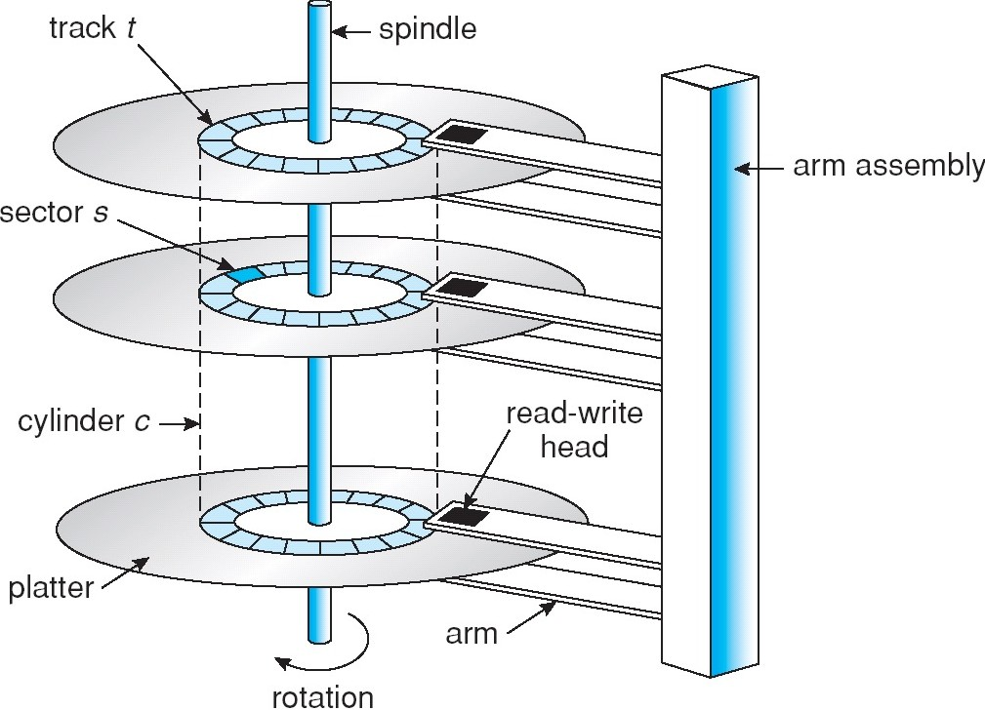
Moving-head Disk Machanism
Silberschatz, Galvin Operating System Concepts – 7th Edition and Gagne ©2005

Slide 7
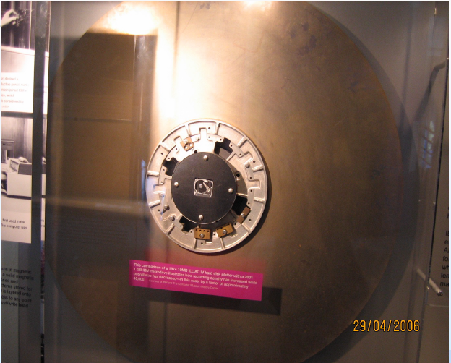
Silberschatz, Galvin Operating System Concepts – 7th Edition and Gagne ©2005

Slide 8

Overview of Mass Storage Structure (Cont.)
Magnetic tape
Was early secondary-storage medium
Relatively permanent and holds large quantities of data
Access time slow
Random access ~1000 times slower than disk
Mainly used for backup, storage of infrequently- used data, transfer medium between systems
Kept in spool and wound or rewound past read- write head
Once data under head, transfer rates comparable to disk
20-200GB typical storage
Common technologies are 4mm, 8mm, 19mm, LTO-2 and SDLT
Silberschatz, Galvin Operating System Concepts – 7th Edition and Gagne ©2005

Slide 9
Disk Structure
Disk drives are addressed as large 1-dimensional arrays of logical blocks, where the logical block is the smallest unit of transfer.
The 1-dimensional array of logical blocks is mapped into the sectors of the disk sequentially.
Sector 0 is the first sector of the first track on the outermost cylinder.
Mapping proceeds in order through that track, then the rest of the tracks in that cylinder, and then through the rest of the cylinders from outermost to innermost.
Silberschatz, Galvin Operating System Concepts – 7th Edition and Gagne ©2005

Slide 10
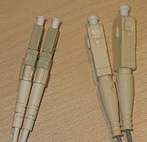
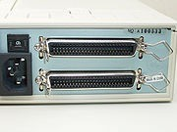


Disk Attachment
Fibre Channel
SCSI
ATA(IDE)
Serial ATA
Silberschatz, Galvin Operating System Concepts – 7th Edition and Gagne ©2005

Slide 11
Disk Attachment
Host-attached storage accessed through I/O ports talking to I/O buses
SCSI(pronounced "scuzzy”) itself is a bus, up to 16 devices on one cable, SCSI initiator requests operation and SCSI targets perform tasks
Each target can have up to 8 logical units (disks attached to device controller
Fibre Channel (FC) is high-speed serial architecture
Commonly running at 2-, 4-, 8- and 16-gigabit per second rates
Can be switched fabric with 24-bit address space – the basis of storage area networks (SANs) in which many hosts attach to many storage units
Can be arbitrated loop (FC-AL) of 126 devices
Silberschatz, Galvin Operating System Concepts – 7th Edition and Gagne ©2005

Slide 12
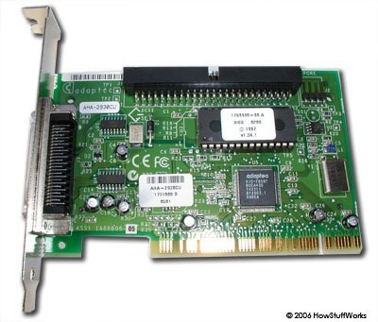
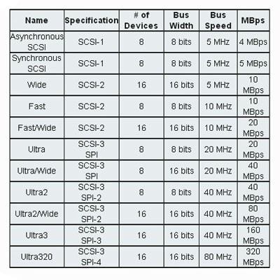
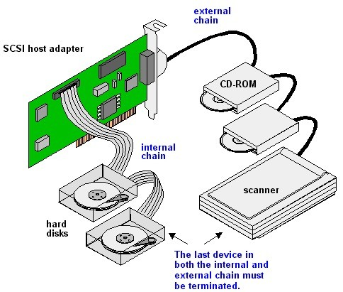
SCSI Interface
Silberschatz, Galvin Operating System Concepts – 7th Edition and Gagne ©2005

Slide 13
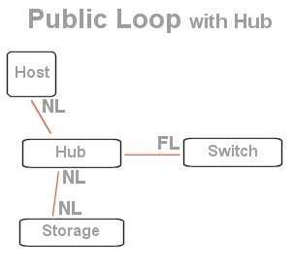
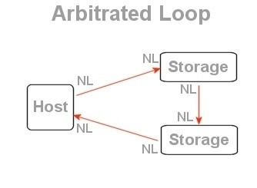
Fibre Channel
Silberschatz, Galvin Operating System Concepts – 7th Edition and Gagne ©2005

Slide 14
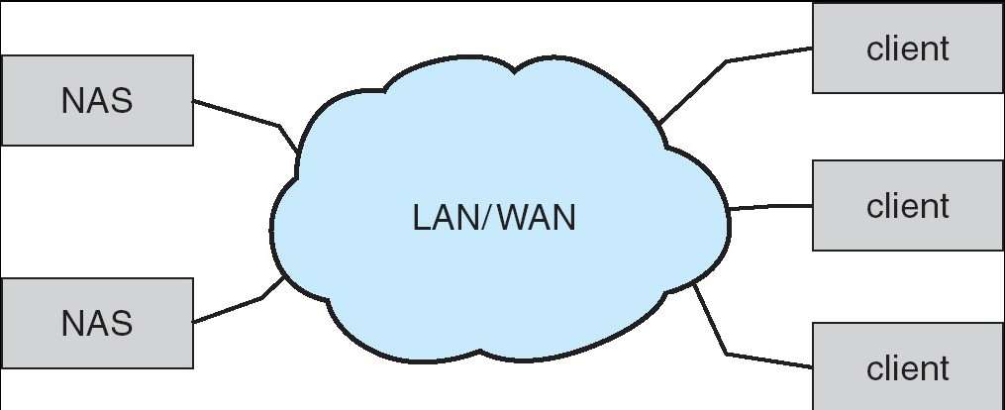
Network-Attached Storage
Network-attached storage (NAS) is storage made available over a network rather than over a local connection (such as a bus)
NFS and CIFS are common protocols
Implemented via remote procedure calls (RPCs) between host and storage
New iSCSI protocol uses IP network to carry the SCSI protocol
Silberschatz, Galvin Operating System Concepts – 7th Edition and Gagne ©2005

Slide 15
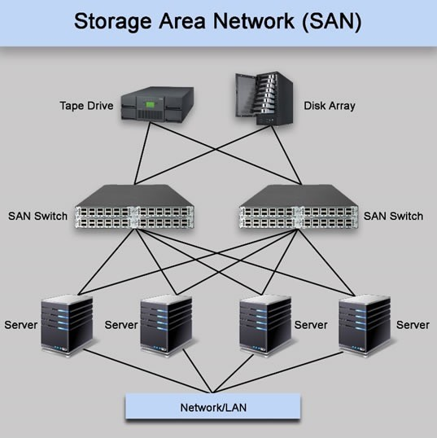
Storage Area Network
Common in large storage environments (and becoming more common)
Multiple hosts attached to multiple storage arrays - flexible
Silberschatz, Galvin Operating System Concepts – 7th Edition and Gagne ©2005

Slide 16
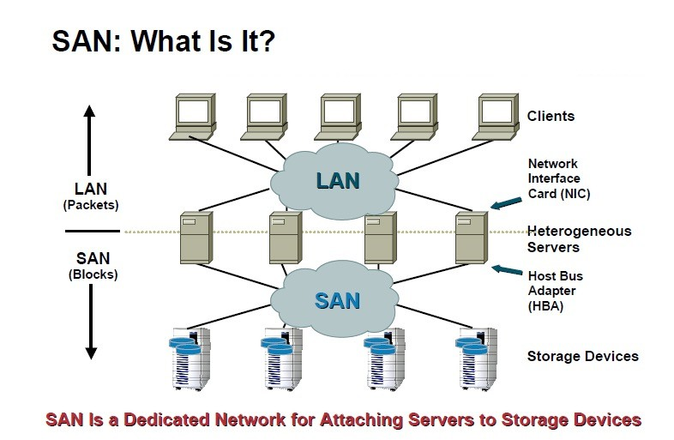
Storage Area Network
Silberschatz, Galvin Operating System Concepts – 7th Edition and Gagne ©2005

Slide 17
Accessing a Disk Page
Time to access (read/write) a disk block:
seek time (moving arms to position disk head on track)
rotational delay (waiting for block to rotate under head)
transfer time (actually moving data to/from disk surface)
Seek time and rotational delay dominate.
Seek time varies from about 1 to 20msec
Rotational delay varies from 0 to 10msec
As of 2010, a typical 7200 RPM desktop HDD has a "disk-to-buffer" data transfer rate up to 1030 Mbit/s
Key to lower I/O cost: reduce seek/rotation delays! Hardware vs. software solutions?
Silberschatz, Galvin Operating System Concepts – 7th Edition and Gagne ©2005

Slide 18
Disk Scheduling
The operating system is responsible for using hardware efficiently — for the disk drives, this means having a fast access time and disk bandwidth.
Access time has two major components
Seek time is the time for the disk are to move the heads to the cylinder containing the desired sector.
Rotational latency is the additional time waiting for the disk to rotate the desired sector to the disk head.
Minimize seek time
Metric: Seek time ≈ seek distance
Disk bandwidth is the total number of bytes transferred, divided by the total time between the first request for service and the completion of the last transfer.
Silberschatz, Galvin Operating System Concepts – 7th Edition and Gagne ©2005

Slide 19
Disk Scheduling (Cont.)
Several algorithms exist to schedule the servicing of disk I/O requests.
We illustrate them with a request queue (0-199).
98, 183, 37, 122, 14, 124, 65, 67
Current head pointer 53
Silberschatz, Galvin Operating System Concepts – 7th Edition and Gagne ©2005

Slide 20
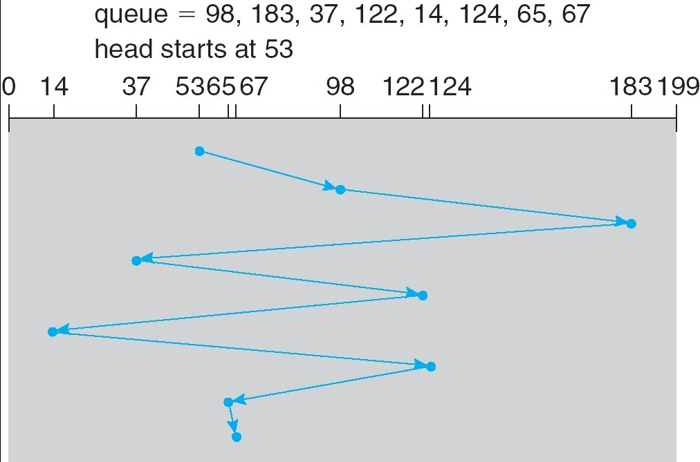
FCFS
Illustration shows total head movement of 640 cylinders.
Silberschatz, Galvin Operating System Concepts – 7th Edition and Gagne ©2005

Slide 21
Shortest-seek-time-first (SSTF)
Selects the request with the minimum seek time from the current head position.
SSTF scheduling is a form of SJF scheduling; may cause starvation of some requests.
Illustration shows total head movement of 236 cylinders.
Silberschatz, Galvin Operating System Concepts – 7th Edition and Gagne ©2005

Slide 22
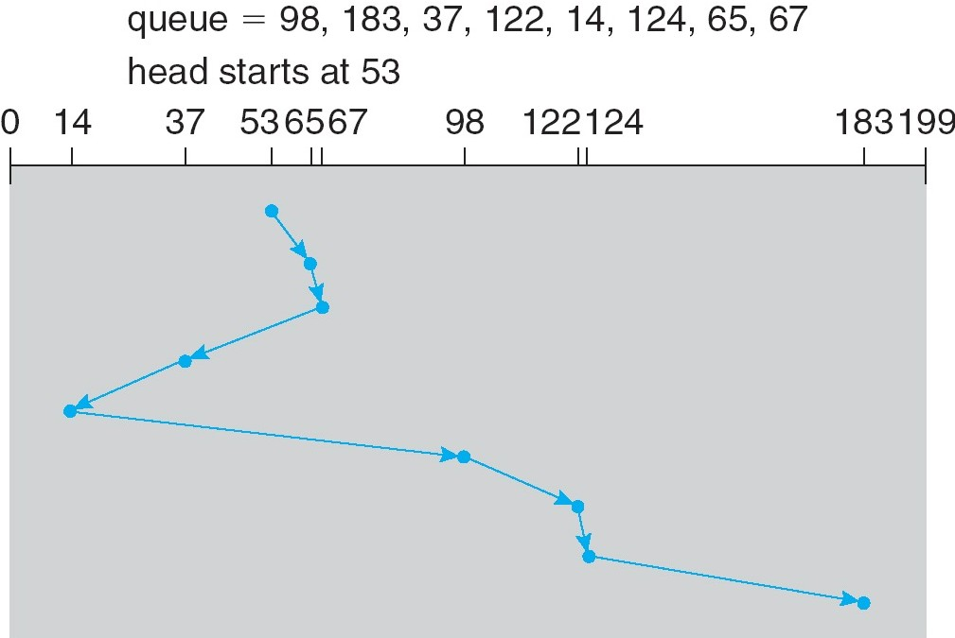
SSTF (Cont.)
Silberschatz, Galvin Operating System Concepts – 7th Edition and Gagne ©2005

Slide 23
SCAN
The disk arm starts at one end of the disk, and moves toward the other end, servicing requests until it gets to the other end of the disk, where the head movement is reversed and servicing continues.
Sometimes called the elevator algorithm.
Silberschatz, Galvin Operating System Concepts – 7th Edition and Gagne ©2005

Slide 24
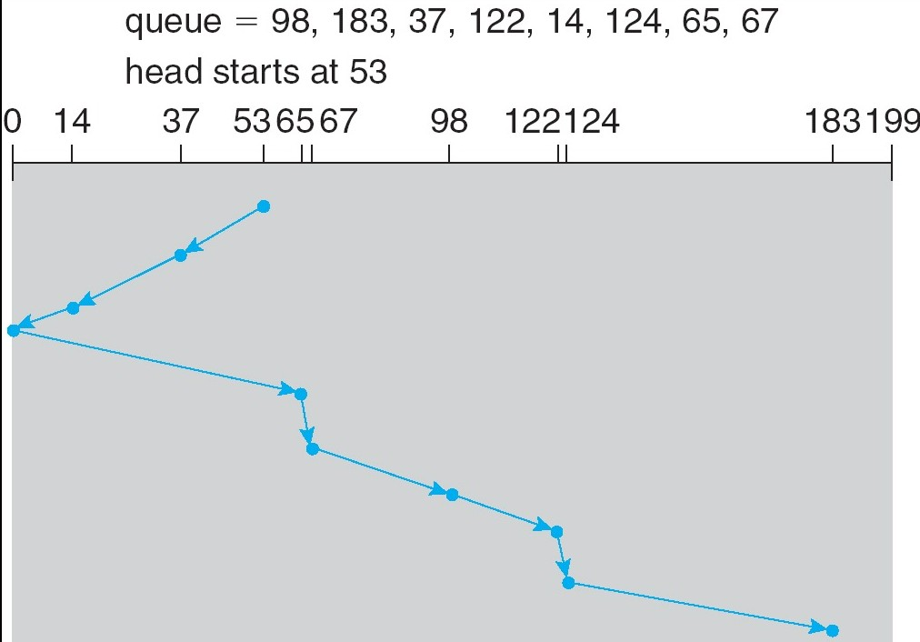
SCAN (Cont.)
Look
LOOK needs total head movement of 208 cylinders.
Silberschatz, Galvin Operating System Concepts – 7th Edition and Gagne ©2005

Slide 25
C-SCAN
Provides a more uniform wait time than SCAN.
The head moves from one end of the disk to the other. servicing requests as it goes. When it reaches the other end, however, it immediately returns to the beginning of the disk, without servicing any requests on the return trip.
Treats the cylinders as a circular list that wraps around from the last cylinder to the first one.
Silberschatz, Galvin Operating System Concepts – 7th Edition and Gagne ©2005

Slide 26
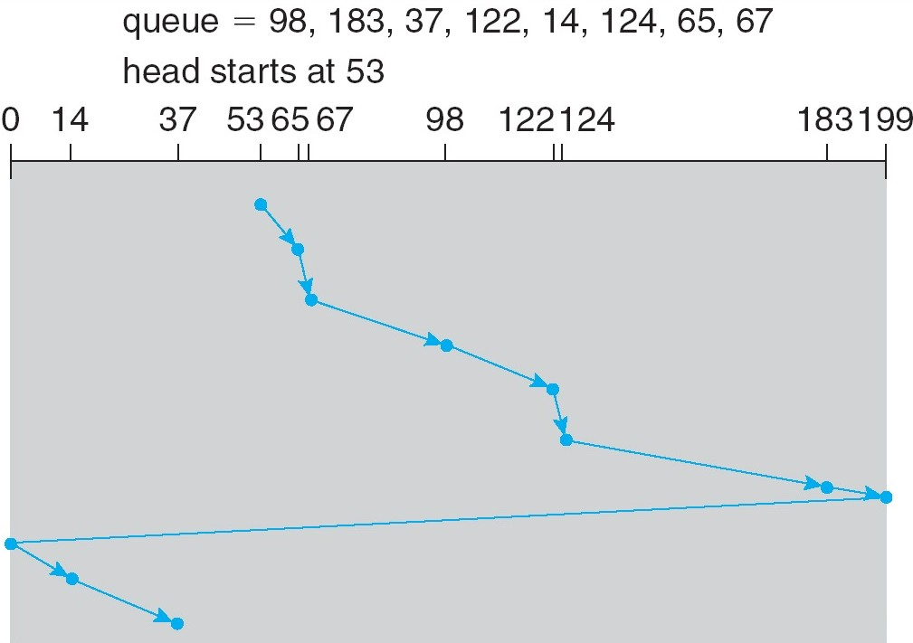
C-SCAN (Cont.)
Silberschatz, Galvin Operating System Concepts – 7th Edition and Gagne ©2005

Slide 27
C-LOOK
Version of C-SCAN
Arm only goes as far as the last request in each direction, then reverses direction immediately, without first going all the way to the end of the disk.
Silberschatz, Galvin Operating System Concepts – 7th Edition and Gagne ©2005

Slide 28
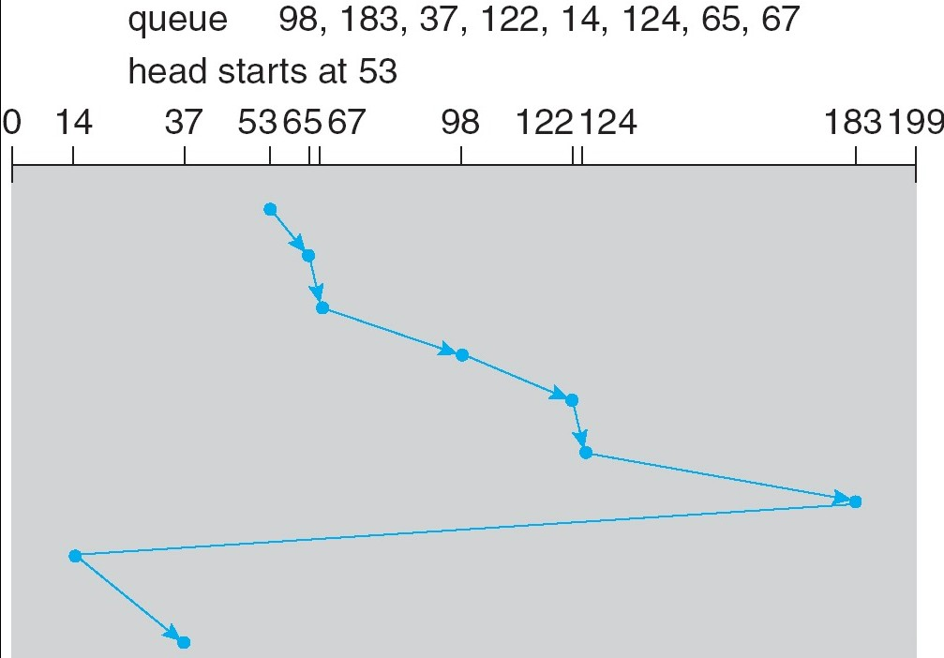
C-LOOK (Cont.)
Silberschatz, Galvin Operating System Concepts – 7th Edition and Gagne ©2005

Slide 29
Selecting a Disk-Scheduling Algorithm
SSTF is common and has a natural appeal
SCAN and C-SCAN perform better for systems that place a heavy load on the disk.
Performance depends on the number and types of requests.
Requests for disk service can be influenced by the file-allocation method.
The disk-scheduling algorithm should be written as a separate module of the operating system, allowing it to be replaced with a different algorithm if necessary.
Either SSTF or LOOK is a reasonable choice for the default algorithm.
Silberschatz, Galvin Operating System Concepts – 7th Edition and Gagne ©2005

Slide 30
Disk Management
Low-level formatting, or physical formatting — Dividing a disk into sectors that the disk controller can read and write.
To use a disk to hold files, the operating system still needs to record its own data structures on the disk.
Partition the disk into one or more groups of cylinders.
Logical formatting or “making a file system”.
Boot block initializes system.
The bootstrap is stored in ROM.
Bootstrap loader program.
Methods such as sector sparing used to handle bad blocks.
Silberschatz, Galvin Operating System Concepts – 7th Edition and Gagne ©2005

Slide 31
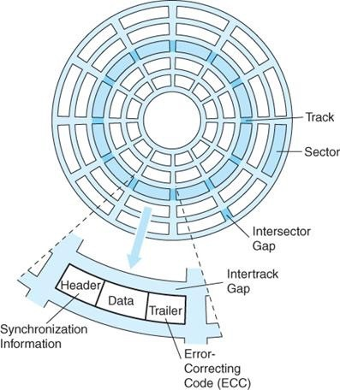
Disk Sector
Silberschatz, Galvin Operating System Concepts – 7th Edition and Gagne ©2005

Slide 32
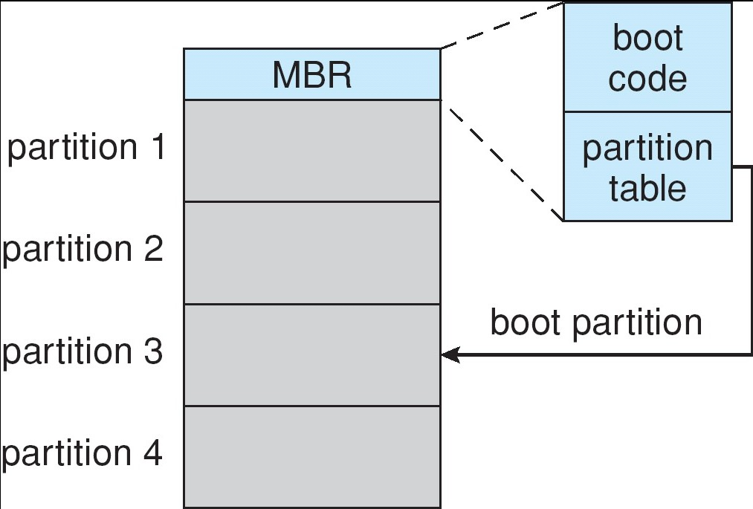
Booting from a Disk in Windows 2000
Silberschatz, Galvin Operating System Concepts – 7th Edition and Gagne ©2005

Slide 33
Swap-Space Management
Swap-space — Virtual memory uses disk space as an extension of main memory.
Swap-space can be carved out of the normal file system,or, more commonly, it can be in a separate disk partition.
Swap-space management
4.3BSD allocates swap space when process starts; holds text segment (the program) and data segment.
Kernel uses swap maps to track swap-space use.
Solaris 2 allocates swap space only when a page is forced out of physical memory, not when the virtual memory page is first created.
Silberschatz, Galvin Operating System Concepts – 7th Edition and Gagne ©2005

Slide 34
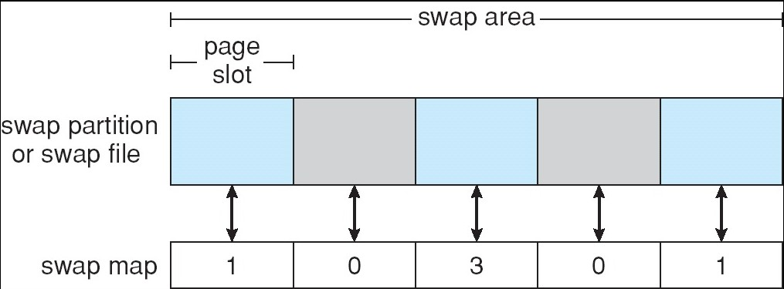
Data Structures for Swapping on Linux Systems
Silberschatz, Galvin Operating System Concepts – 7th Edition and Gagne ©2005

Slide 35
RAID Structure
RAID – multiple disk drives provides reliability via redundancy.
RAID is arranged into six different levels.
RAID = redundant arrays of inexpensive disks
Silberschatz, Galvin Operating System Concepts – 7th Edition and Gagne ©2005

Slide 36
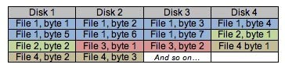
RAID (cont)
Several improvements in disk-use techniques involve the use of multiple disks working cooperatively.
Disk striping uses a group of disks as one storage unit.
Bit-level Striping
Block-level Striping – different blocks of a file are striped
RAID schemes improve performance and improve the reliability of the storage system by storing redundant data.
Mirroring or shadowing keeps duplicate of each disk.
Block interleaved parity uses much less redundancy.
Silberschatz, Galvin Operating System Concepts – 7th Edition and Gagne ©2005

Slide 37
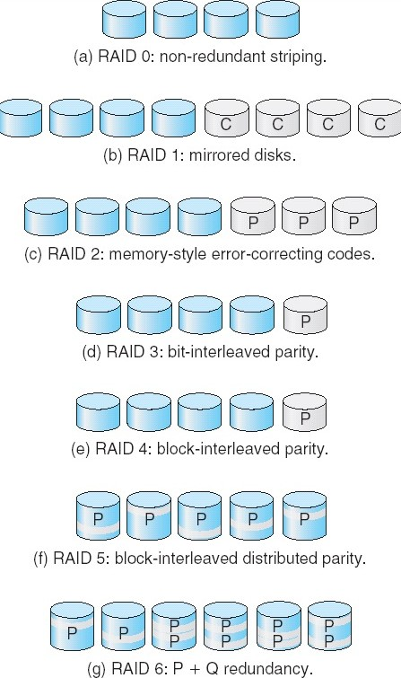
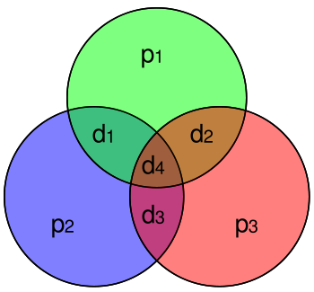
RAID Levels
ECC, Hamming(7, 4)
Silberschatz, Galvin Operating System Concepts – 7th Edition and Gagne ©2005

Slide 38
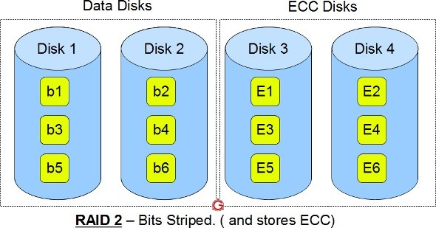
Raid 2
Silberschatz, Galvin Operating System Concepts – 7th Edition and Gagne ©2005

Slide 39
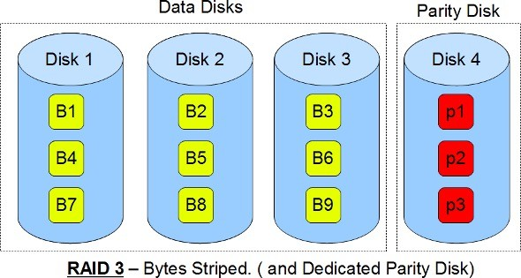
RAID 3
Sequential read and write will have good performance. Random read and write will have worst performance.
Silberschatz, Galvin Operating System Concepts – 7th Edition and Gagne ©2005

Slide 40
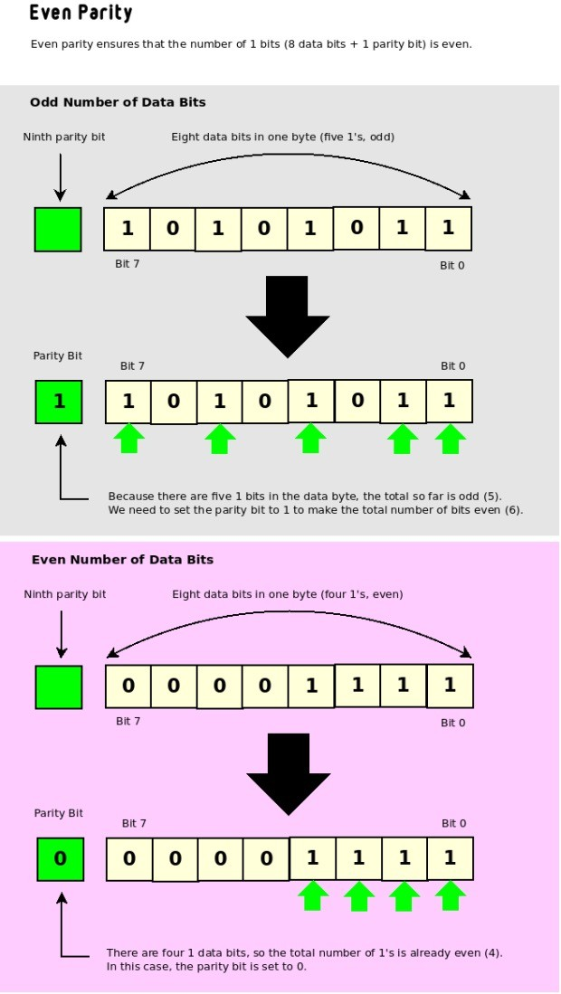
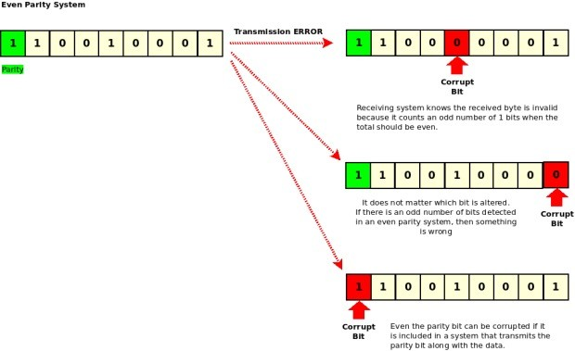
Parity (Even) Bit
Silberschatz, Galvin Operating System Concepts – 7th Edition and Gagne ©2005

Slide 41
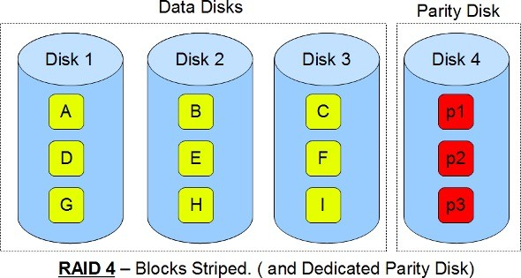
RAID 4
Minimum of 3 disks (2 disks for data and 1 for parity) Good random reads, as the data blocks are striped.
Bad random writes, as for every write, it has to write to the single parity disk.
Silberschatz, Galvin Operating System Concepts – 7th Edition and Gagne ©2005

Slide 42
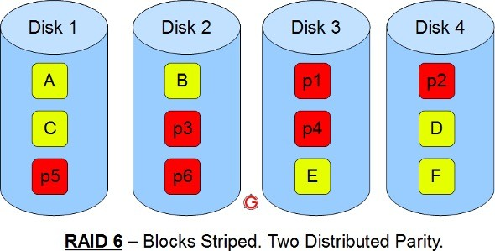
RAID 6
Silberschatz, Galvin Operating System Concepts – 7th Edition and Gagne ©2005

Slide 43
RAID Level
RAID 1: Provides fault tolerance from disk errors and failure of all but one of the drives. Increased read performance occurs when using a multi-threaded operating system that supports split seeks, very small performance reduction when writing. Array continues to operate so long as at least one drive is functioning.
RAID 2: memory-style Hamming code parity. Not really practical.
RAID 3: The single parity disk is a bottle-neck for writing since every write requires updating the parity data.
RAID 4: Identical with RAID 3 except using block level parity. The parity disk can become a bottleneck. Large (parallel) reads and writes are good. Small write causes 4 page accesses.
RAID 5: Distributed parity requires all drives but one to be present to operate; drive failure requires replacement, but the array is not destroyed by a single drive failure.
RAID 6: extra redundancy information to guard multiple disk failures.
Silberschatz, Galvin Operating System Concepts – 7th Edition and Gagne ©2005

Slide 44
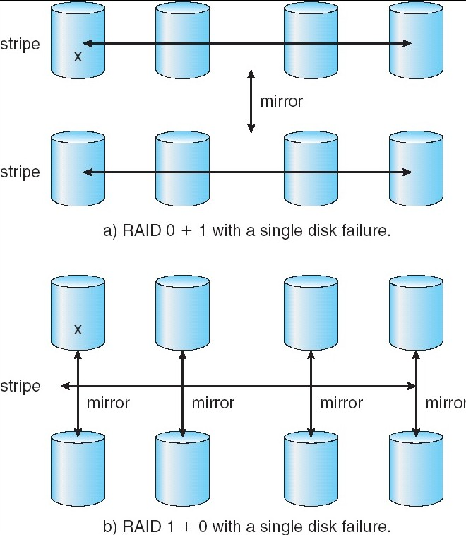
RAID (0 + 1) and (1 + 0)
Stripe and then mirror
Mirror and then stripe
Silberschatz, Galvin Operating System Concepts – 7th Edition and Gagne ©2005

Slide 45
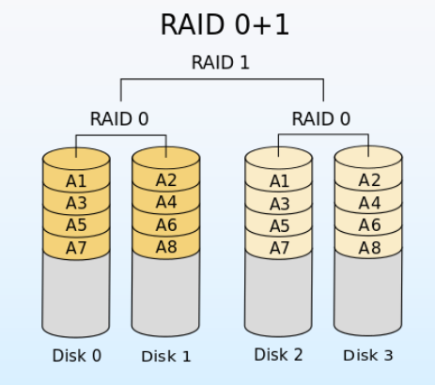
RAID 0+1
Silberschatz, Galvin Operating System Concepts – 7th Edition and Gagne ©2005

Slide 46
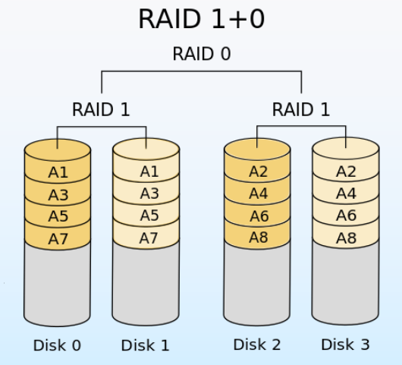
RAID 1+0
Silberschatz, Galvin Operating System Concepts – 7th Edition and Gagne ©2005

Slide 47
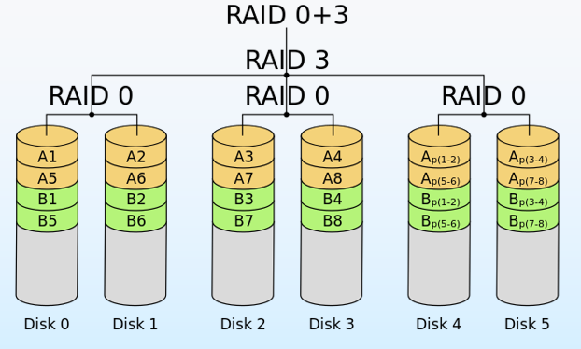
RAID 0+3
Silberschatz, Galvin Operating System Concepts – 7th Edition and Gagne ©2005

Slide 48
Stable-Storage Implementation
Write-ahead log scheme requires stable storage.
To implement stable storage:
Replicate information on more than one nonvolatile storage media with independent failure modes.
Update information in a controlled manner to ensure that we can recover the stable data after any failure during data transfer or recovery.
Silberschatz, Galvin Operating System Concepts – 7th Edition and Gagne ©2005

Slide 49
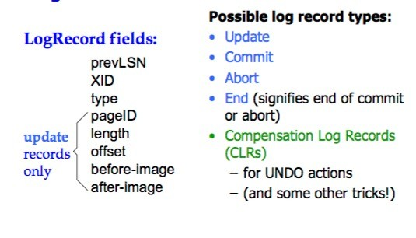
ARIES Log
Silberschatz, Galvin Operating System Concepts – 7th Edition and Gagne ©2005

Slide 50
ARIES Log
Silberschatz, Galvin Operating System Concepts – 7th Edition and Gagne ©2005

Slide 51
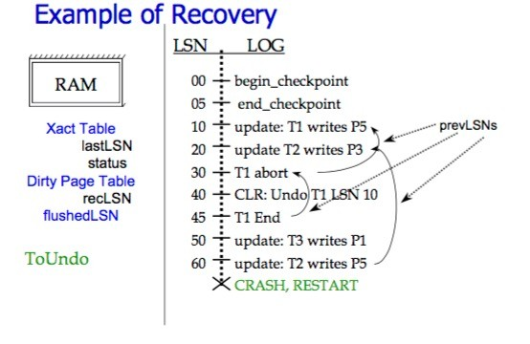
ARIES Log
Silberschatz, Galvin Operating System Concepts – 7th Edition and Gagne ©2005

Slide 52
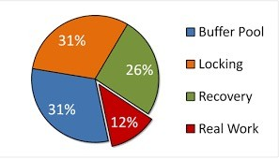

What’s the Problem??
Most CPU time is not used to do the right thing.
Silberschatz, Galvin Operating System Concepts – 7th Edition and Gagne ©2005

Slide 53
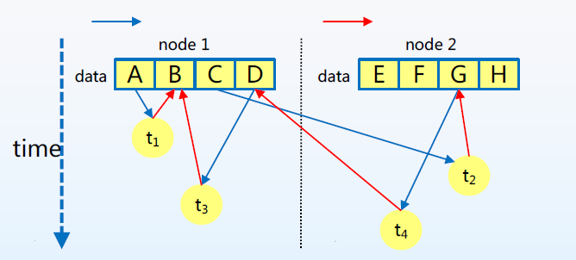
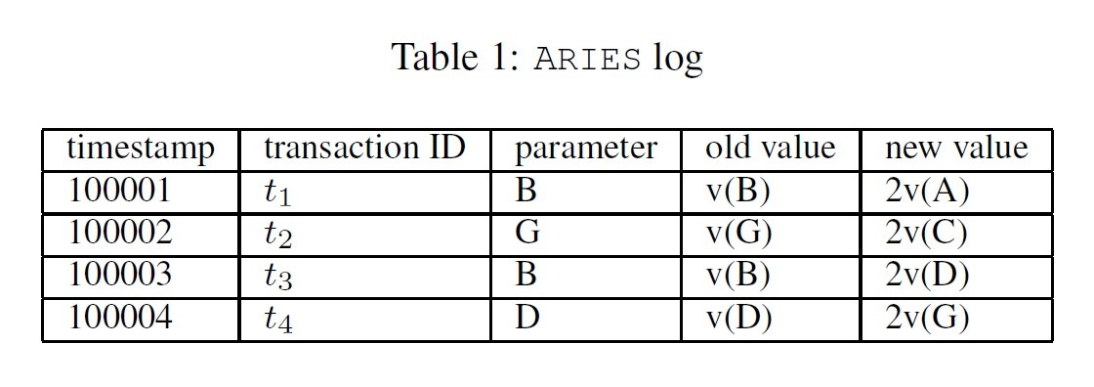
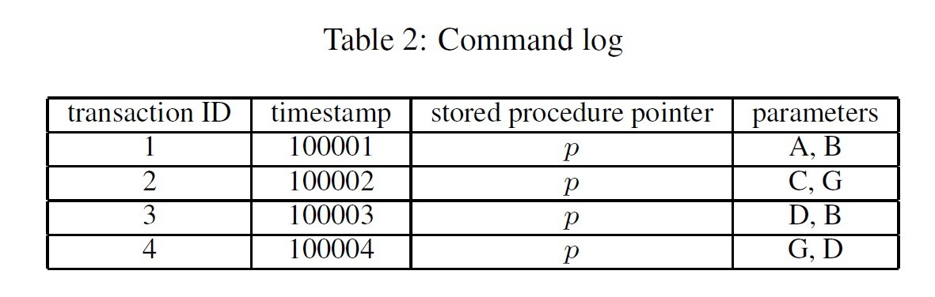
Command Log (ICDE 2015、SIGMOD 2016)
Fig 1. Example of logging techniques
Silberschatz, Galvin Operating System Concepts – 7th Edition and Gagne ©2005

Slide 54
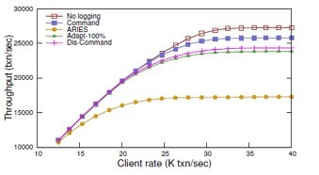
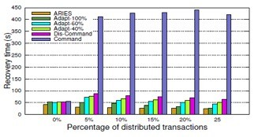
Command Log (ICDE 2015、SIGMOD 2016)
Silberschatz, Galvin Operating System Concepts – 7th Edition and Gagne ©2005

Slide 55
Command Log (ICDE 2015、SIGMOD 2016)
Command Log (ICDE 2015、SIGMOD 2016)
 | ARIES logging | Command Logging
Number of Log Records | More | Less
Log Size | Large | Small
Complexity of Log Construction | High | Low
OLTP system with Command Logging achieves higher performance during the runtime.
 | ARIES logging | Command Logging
Transaction Replay | Fast | Slow
Recovery | Only the failed nodes invoke recovery processes and work independently | The nodes in the cluster invoke recovery processes simultaneously and in a synchronous way
OLTP system with ARIES logging achieves fast and independent recovery.
Silberschatz, Galvin Operating System Concepts – 7th Edition and Gagne ©2005

Slide 56
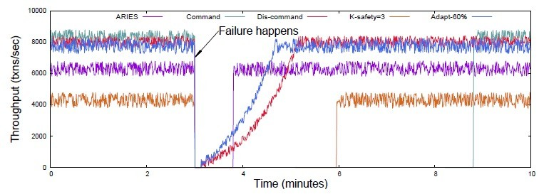
Entire-cluster failure
Throughput evaluation on the TPC-C benchmark when the entire cluster fails
Silberschatz, Galvin Operating System Concepts – 7th Edition and Gagne ©2005

Slide 57
Tertiary Storage Devices
Low cost is the defining characteristic of tertiary storage.
Generally, tertiary storage is built using removable media
Common examples of removable media are floppy disks and CD- ROMs; other types are available.
Silberschatz, Galvin Operating System Concepts – 7th Edition and Gagne ©2005

Slide 58
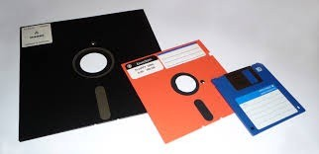
Removable Disks
Floppy disk — thin flexible disk coated with magnetic material, enclosed in a protective plastic case.
Most floppies hold about 1 MB; similar technology is used for removable disks that hold more than 1 GB.
Removable magnetic disks can be nearly as fast as hard disks, but they are at a greater risk of damage from exposure.
Silberschatz, Galvin Operating System Concepts – 7th Edition and Gagne ©2005

Slide 59
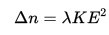
Removable Disks (Cont.)
A magneto-optic disk records data on a rigid platter coated with magnetic material.
Laser heat is used to amplify a large, weak magnetic field to record a bit.
Laser light is also used to read data (Kerr effect).
The magneto-optic head flies much farther from the disk surface than a magnetic disk head, and the magnetic material is covered with a protective layer of plastic or glass; resistant to head crashes.
Optical disks do not use magnetism; they employ special materials that are altered by laser light.
Silberschatz, Galvin Operating System Concepts – 7th Edition and Gagne ©2005

Slide 60
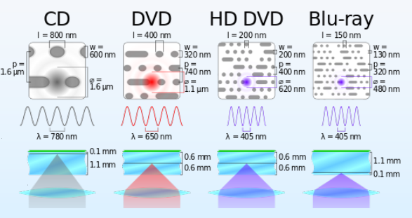
Evolvement of Optical Disk
Silberschatz, Galvin Operating System Concepts – 7th Edition and Gagne ©2005

Slide 61
WORM Disks
The data on read-write disks can be modified over and over.
WORM (“Write Once, Read Many Times”) disks can be written only once.
Thin aluminum film sandwiched between two glass or plastic platters.
To write a bit, the drive uses a laser light to burn a small hole through the aluminum; information can be destroyed but not altered.
Very durable and reliable.
Read Only disks, such ad CD-ROM and DVD, come from the factory with the data pre-recorded.
Silberschatz, Galvin Operating System Concepts – 7th Edition and Gagne ©2005

Slide 62
Tapes
Compared to a disk, a tape is less expensive and holds more data, but random access is much slower.
Tape is an economical medium for purposes that do not require fast random access, e.g., backup copies of disk data, holding huge volumes of data.
Large tape installations typically use robotic tape changers that move tapes between tape drives and storage slots in a tape library.
stacker – library that holds a few tapes
silo – library that holds thousands of tapes
A disk-resident file can be archived to tape for low cost storage; the computer can stage it back into disk storage for active use.
Silberschatz, Galvin Operating System Concepts – 7th Edition and Gagne ©2005

Slide 63
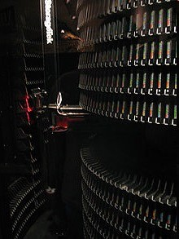
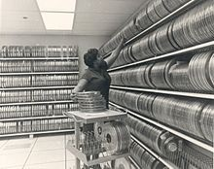
Tape Library
Silberschatz, Galvin Operating System Concepts – 7th Edition and Gagne ©2005

Slide 64
Operating System Issues
Major OS jobs are to manage physical devices and to present a virtual machine abstraction to applications
For hard disks, the OS provides two abstraction:
Raw device – an array of data blocks.
File system – the OS queues and schedules the interleaved requests from several applications.
Silberschatz, Galvin Operating System Concepts – 7th Edition and Gagne ©2005

Slide 65
Application Interface
Most OSs handle removable disks almost exactly like fixed disks — a new cartridge is formatted and an empty file system is generated on the disk.
Tapes are presented as a raw storage medium, i.e., and application does not open a file on the tape, it opens the whole tape drive as a raw device.
Usually the tape drive is reserved for the exclusive use of that application.
Since the OS does not provide file system services, the application must decide how to use the array of blocks.
Since every application makes up its own rules for how to organize a tape, a tape full of data can generally only be used by the program that created it.
Silberschatz, Galvin Operating System Concepts – 7th Edition and Gagne ©2005

Slide 66
Tape Drives
The basic operations for a tape drive differ from those of a disk drive.
locate positions the tape to a specific logical block, not an entire track (corresponds to seek).
The read position operation returns the logical block number where the tape head is.
The space operation enables relative motion.
Tape drives are “append-only” devices; updating a block in the middle of the tape also effectively erases everything beyond that block.
An EOT mark is placed after a block that is written.
Silberschatz, Galvin Operating System Concepts – 7th Edition and Gagne ©2005

Slide 67
File Naming
The issue of naming files on removable media is especially difficult when we want to write data on a removable cartridge on one computer, and then use the cartridge in another computer.
Contemporary OSs generally leave the name space problem unsolved for removable media, and depend on applications and users to figure out how to access and interpret the data.
Some kinds of removable media (e.g., CDs) are so well standardized that all computers use them the same way.
Silberschatz, Galvin Operating System Concepts – 7th Edition and Gagne ©2005

Slide 68
Hierarchical Storage Management (HSM)
A hierarchical storage system extends the storage hierarchy beyond primary memory and secondary storage to incorporate tertiary storage — usually implemented as a jukebox of tapes or removable disks.
Usually incorporate tertiary storage by extending the file system.
Small and frequently used files remain on disk.
Large, old, inactive files are archived to the jukebox.
HSM is usually found in supercomputing centers and other large installations that have enormous volumes of data.
Silberschatz, Galvin Operating System Concepts – 7th Edition and Gagne ©2005

Slide 69
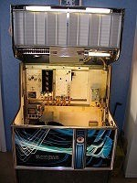

A Jukebox
Silberschatz, Galvin Operating System Concepts – 7th Edition and Gagne ©2005

Slide 70
Speed
Two aspects of speed in tertiary storage are bandwidth and latency.
Bandwidth is measured in bytes per second.
Sustained bandwidth – average data rate during a large transfer; # of bytes/transfer time.
Data rate when the data stream is actually flowing.
Effective bandwidth – average over the entire I/O time, including
seek or locate, and cartridge switching. Drive’s overall data rate.
Silberschatz, Galvin Operating System Concepts – 7th Edition and Gagne ©2005

Slide 71
Speed (Cont.)
Access latency – amount of time needed to locate data.
Access time for a disk – move the arm to the selected cylinder and wait for the rotational latency; < 35 milliseconds.
Access on tape requires winding the tape reels until the selected block reaches the tape head; tens or hundreds of seconds.
Generally say that random access within a tape cartridge is about a thousand times slower than random access on disk.
The low cost of tertiary storage is a result of having many cheap cartridges share a few expensive drives.
A removable library is best devoted to the storage of infrequently used data, because the library can only satisfy a relatively small number of I/O requests per hour.
Silberschatz, Galvin Operating System Concepts – 7th Edition and Gagne ©2005

Slide 72
Reliability
A fixed disk drive is likely to be more reliable than a removable disk or tape drive.
An optical cartridge is likely to be more reliable than a magnetic disk or tape.
A head crash in a fixed hard disk generally destroys the data, whereas the failure of a tape drive or optical disk drive often leaves the data cartridge unharmed.
Silberschatz, Galvin Operating System Concepts – 7th Edition and Gagne ©2005

Slide 73
Cost
Main memory is much more expensive than disk storage
The cost per megabyte of hard disk storage is competitive with magnetic tape if only one tape is used per drive.
The cheapest tape drives and the cheapest disk drives have had about the same storage capacity over the years.
Tertiary storage gives a cost savings only when the number of cartridges is considerably larger than the number of drives.
Silberschatz, Galvin Operating System Concepts – 7th Edition and Gagne ©2005

Slide 74
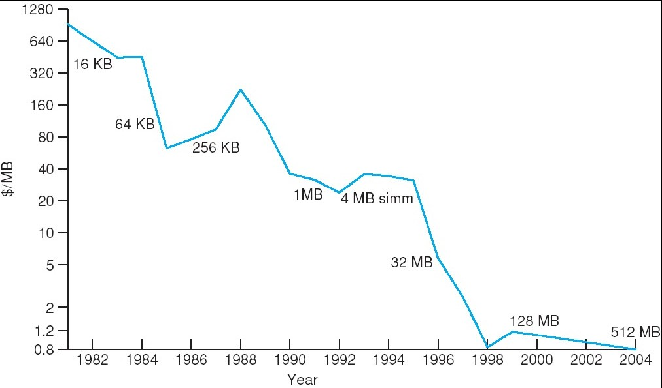
Price per Megabyte of DRAM, From 1981 to 2004
Silberschatz, Galvin Operating System Concepts – 7th Edition and Gagne ©2005

Slide 75
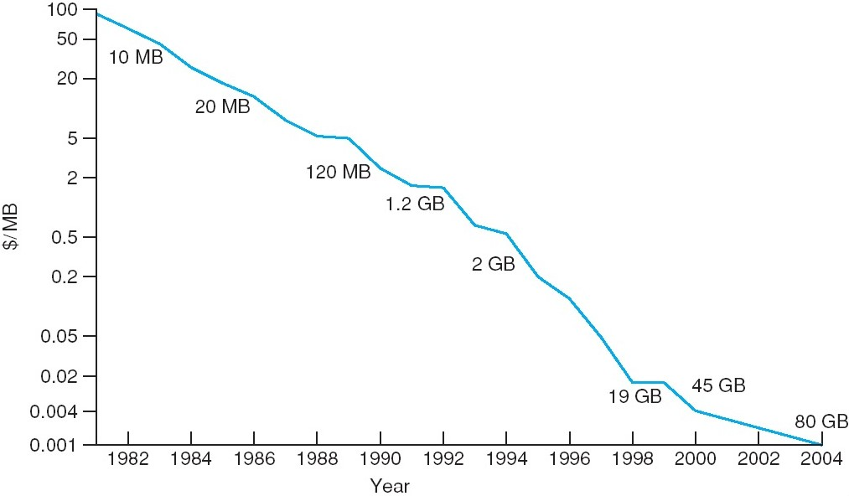
Price per Megabyte of Magnetic Hard Disk, From 1981 to 2004
Silberschatz, Galvin Operating System Concepts – 7th Edition and Gagne ©2005

Slide 76

Price per Megabyte of a Tape Drive, From 1984-2000
Silberschatz, Galvin Operating System Concepts – 7th Edition and Gagne ©2005

Slide 77

An Introduction to MapReduce (Hadoop)
MapReduce
To simplify the parallel processing on a large cluster, Google proposes MapReduce framework
Silberschatz, Galvin Operating System Concepts – 7th Edition and Gagne ©2005

Slide 78


What is MapReduce
❻ Two customizable interfaces: map and reduce
Reduce
Map
Silberschatz, Galvin Operating System Concepts – 7th Edition and Gagne ©2005

Slide 79

MapReduce Framework
Silberschatz, Galvin Operating System Concepts – 7th Edition and Gagne ©2005

Slide 80

MapReduce Job: Word Count
Silberschatz, Galvin Operating System Concepts – 7th Edition and Gagne ©2005

Slide 81
HDFS (Hadoop Distributed File System)
HDFS is an open source implementation of Google File System
HDFS is designed for
Storing large files
Terabytes, Petabytes, etc...
Millions rather than billions of files – 100MB or more per file
Streaming data
Write once and read-many times patterns
Optimized for streaming reads rather than random reads – Append operation added to Hadoop 0.21
“Cheap” Commodity Hardware
No need for super-computers, use less reliable commodity hardware
Silberschatz, Galvin Operating System Concepts – 7th Edition and Gagne ©2005

Slide 82
HDFS (Hadoop Distributed File System)
HDFS is not designed for
Low-latency reads
High-throughput rather than low latency for small chunks of data
HBase addresses this issue
Large amount of small files
Better for millions of large files instead of billions of small files
For example each file can be 100MB or more • Multiple Writers
Single writer per file
Writes only at the end of file, no-support for arbitrary offset
Silberschatz, Galvin Operating System Concepts – 7th Edition and Gagne ©2005

Slide 83

Architecture of HDFS
One Namenode
One Second Namenode
Multiple Datanode
Silberschatz, Galvin Operating System Concepts – 7th Edition and Gagne ©2005

Slide 84
File Blocks
Files are split into blocks (single unit of storage)
Managed by Namenode, stored by Datanode
Transparent to user
Replicated across machines at load time
Same block is stored on multiple machines
Good for fault-tolerance and access
Default replication is 3
Blocks are traditionally either 64MB or 128MB
Default is 64MB
The motivation is to minimize the cost of seeks as compared to transfer rate
'Time to transfer' > 'Time to seek'
For example, lets say – seek time = 10ms
Transfer rate = 100 MB/s
To achieve seek time of 1% transfer rate – Block size will need to be = 100MB
Silberschatz, Galvin Operating System Concepts – 7th Edition and Gagne ©2005

Slide 85

File Blocks
Silberschatz, Galvin Operating System Concepts – 7th Edition and Gagne ©2005

Slide 86

Clients Write in HDFS
Silberschatz, Galvin Operating System Concepts – 7th Edition and Gagne ©2005

Slide 87

Client Read in HDFS
Silberschatz, Galvin Operating System Concepts – 7th Edition and Gagne ©2005

Slide 88
Bottleneck of the Namenode
For fast access Namenode keeps all block metadata in-memory
The bigger the cluster - the more RAM required
Best for millions of large files (100mb or more) rather than billions
Will work well for clusters of 100s machines
Hadoop 2+
Namenode Federations
Each namenode will host part of the blocks • Horizontally scale the Namenode
Support for 1000+ machine clusters • Yahoo! runs 50,000+ machines
Learn more @ http://hadoop.apache.org/docs/r2.0.2- alpha/hadoop-yarn/hadoop-yarn-site/Federation.html
Silberschatz, Galvin Operating System Concepts – 7th Edition and Gagne ©2005

Slide 89

HDFS Java API

Slide 90

Hadoop, the Big Picture
Silberschatz, Galvin Operating System Concepts – 7th Edition and Gagne ©2005

Slide 91

Hadoop Yarn Achitecture
Silberschatz, Galvin Operating System Concepts – 7th Edition and Gagne ©2005

Slide 92

MapReduce Workflow
Silberschatz, Galvin Operating System Concepts – 7th Edition and Gagne ©2005

Slide 93

Functions in Hadoop
InputFormat
Map function
Partitioner
Sorting & Merging
Combiner
Shuffling
Merging
Reduce function
OutputFormat
→ 1:many
Silberschatz, Galvin Operating System Concepts – 7th Edition and Gagne ©2005

Slide 94

Lifecycle of a MapReduce Job
Map function
Reduce function
Run this program as a MapReduce job
Silberschatz, Galvin Operating System Concepts – 7th Edition and Gagne ©2005

Slide 95
Lifecycle of a MapReduce Job
Map function
Reduce function
Run this program as a MapReduce job
Silberschatz, Galvin Operating System Concepts – 7th Edition and Gagne ©2005

Slide 96

Lifecycle of a MapReduce Job
How are the number of splits, number of map and reduce tasks, memory allocation to tasks, etc., determined?
Silberschatz, Galvin Operating System Concepts – 7th Edition and Gagne ©2005

Slide 97

Job Configuration Parameters
190+ parameters in Hadoop
Set manually or defaults are used
Silberschatz, Galvin Operating System Concepts – 7th Edition and Gagne ©2005

Slide 99
Problem
You’ve been hired by Orange Computer to help design a new processor and Orange Pro laptop. After choosing the display, case, and other components, you are left with $460 to spend on the following components:
Item | Latency | Minimum Size | Cost
TLB | 10 ns | 256 entries | $0.10/entry
Main memory | 180 ns | 2 GB | $10/GB
Magnetic Disk | 8 ms (8M ns) | 300 GB | $0.10/GB
The page size is fixed at 64 KB. Assume you want to run up to 20 applications simultaneously. Each application has an overall maximum size of 1 GB and a working set size of 256 MB. TLB entries do not have Process Identifiers. Discuss how you would divide the available funds across the various items to optimize performance.
Silberschatz, Galvin Operating System Concepts – 7th Edition and Gagne ©2005

Slide 100
Problem
❻ We start with the disk. Since the disk is the slowest component of the system, we take the minimum size, 300 GB or $30, leaving us with $430.
Item / Points | 3 points | 2 points | 1 point | 0 points
(a) TLB | 3,800 entries | > 3,800 | < 3,800 | < 256
(b) Memory | 5 GB | > 5 GB | < 5 GB | < 2 GB
(c) Disk | 300 GB | _{l} > 300GB, if using extra money for disk instead of memory or TLB
❻ Since the
the minim
TLB does not c
um number of
ontain process
entries to map t
identifiers, we
he working set
only need
for a single
process –
256 MB / 64 K
B = 4,096 entri
es or $409.60,
leaving us
with $21.4
❻ With the re
0.
maining mone
y, we could bu
y 2 GB. Howev
er, since the
maximum
of 256 MB,
so we sho
❻ While this increase t
number of app
we should pr uld spend $38
will cause TLB he TLB any mo
ications is 20
ovide 5 GB of 0 on 3,800 entr
misses, it doe re, since that
each with a wo
RAM ($50) to av ies.
s not make se would require t
rking set size
oid paging,
nse to hat we
decrease the memory size below the requirements for the applications; a situation that will cause the system to start paging.
Silberschatz, Galvin Operating System Concepts – 7th Edition and Gagne ©2005

